Slide 1
Spam Filtering
Noah Portnoy and Andrew Sousa

Slide 2
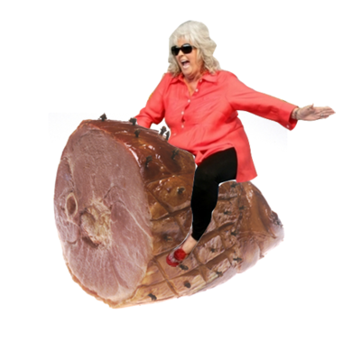
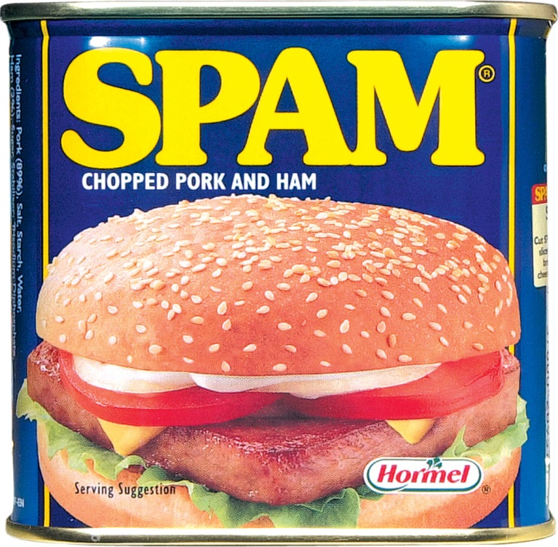
Spam is bad
Ham is good

Slide 3
How do we detect this as spam?
From: makelotsofcash@hotmail.com
Subject: FINANCIAL FREEDOM
Dear Friend,
How would you like to make $50,000 in the next 90 days? Sounds impossible?
I guarantee that it's true, and YOU can do it. I'm sure you would like an
extra $50,000 to spend. For more information, please click on the website
below.
http://www.geocities.com/akcina/index.html
If the above link does not work, please copy the address and paste it into
your web browser.
AT THE VERY LEAST TAKE A MINUTE TO LOOK AT WHAT IS ON THE SITE, IT MAY
CHANGE YOUR LIFE FOREVER.

Slide 4
How do we detect this as spam?
From: mr.dada0001@gmail.com
Subject: Greetings to you my friend.
Greetings to you my friend,
I know this will come to you as a surprise because you do not know me.
I am John Alison I work in Central Bank of Nigeria, packaging and courier department.
I got your contact among others from a search on the internet and I was inspired to seek your co-operation, I want you to help me clear this consignment that is already in theEurope which I shipped through or CBN accredited courier agent. The content of the package is $20,000,000.00 all in $100 bills, but the courier company does not know that the consignment contains money…

Slide 5
The answer: Bayesian spam filtering

Slide 6
Training the filter
spam
corpus
ham
corpus
bad word
good word
word frequency counter

Slide 7

Determining spam rankings
$$P\left(spam | word\right)= \frac{P\left(word | spam\right)}{P\left(word | spam\right)+P\left(word | ham\right)}$$

Slide 8
word | frequency in spam corpus | frequency in ham corpus | spam ranking
hello | 53 | 28 | 0.4872
free | 1625 | 158 | 0.7685
thanks | 67 | 135 | 0.1994
friend | 79 | 31 | 0.5612
click | 1354 | 23 | 0.9580
nigeria | 58 | 7 | 0.8062
hey | 13 | 21 | 0.2371
sir | 32 | 7 | 0.6946
sales | 225 | 7 | 0.9516

Slide 9
Filtering unknown messages

Slide 10
Majority method
word | spam ranking
dreamed | 0.99
apology | 0.99
signup | 0.99
sincere | 0.99
click | 0.957991
earn | 0.946141
financially | 0.944645
marketing | 0.944504
sales | 0.941633
receive | 0.935902
root | 0.08116
tuatha | 0.071936
flowed | 0.050182
listmaster | 0.047491
maintainer | 0.045326
threshold = 0.9

Slide 11

Mean averaging method
word | spam ranking
dreamed | 0.99
apology | 0.99
signup | 0.99
sincere | 0.99
click | 0.957991
earn | 0.946141
financially | 0.944645
marketing | 0.944504
sales | 0.941633
receive | 0.935902
root | 0.08116
tuatha | 0.071936
flowed | 0.050182
listmaster | 0.047491
maintainer | 0.045326
Compare the mean
to a threshold
$P\left(message is spam\right)$ = 0.6618

Slide 12

Naïve Bayes classifier method
$P\left(message is spam\right)=\frac{p_{1}p_{2}p_{3}⋯p_{15}}{p_{1}p_{2}p_{3}⋯p_{15}+\left(1−p_{1}\right)\left(1−p_{1}\right)⋯(1−p_{15})}$
$$if P\left(message is spam\right)≥threshold → spam$$

Slide 13

Naïve Bayes classifier method
word | spam ranking
dreamed | 0.99
apology | 0.99
signup | 0.99
sincere | 0.99
click | 0.957991
earn | 0.946141
financially | 0.944645
marketing | 0.944504
sales | 0.941633
receive | 0.935902
root | 0.08116
tuatha | 0.071936
flowed | 0.050182
listmaster | 0.047491
maintainer | 0.045326
$P\left(message is spam\right)$ = 0.999999995

Slide 14
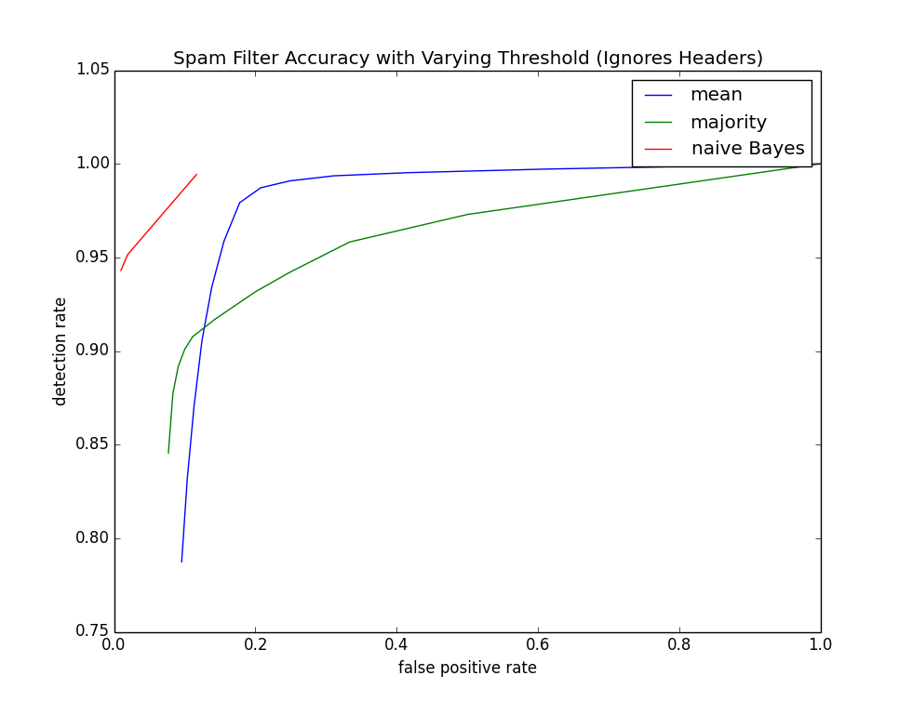

Slide 15
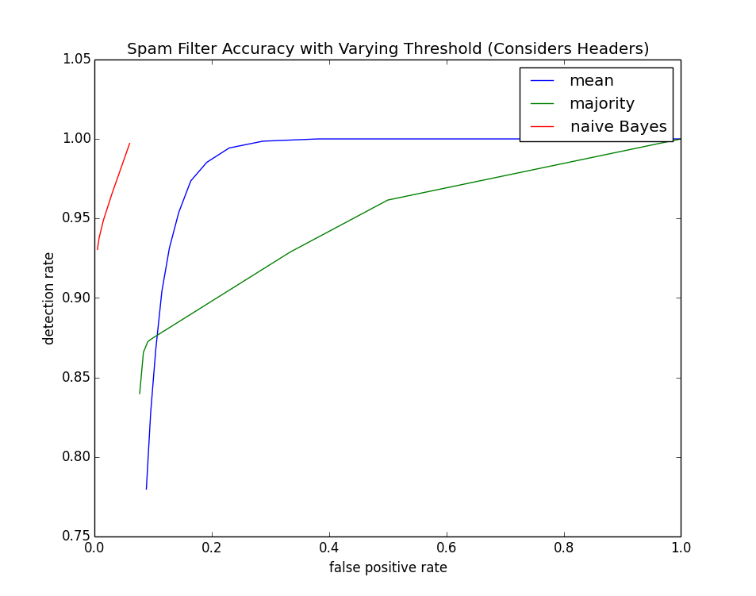
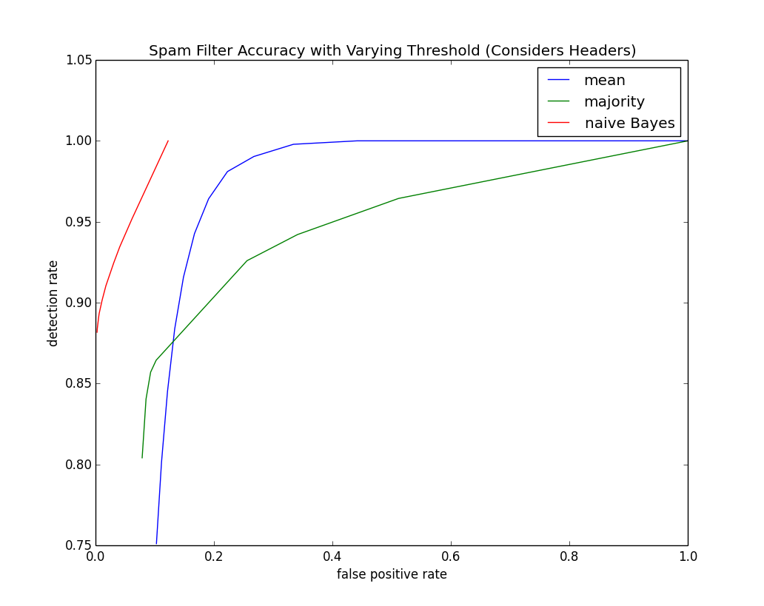

Slide 16
Bayesian spam filtering is very accurate

Slide 17

Demo!

